Slide 1
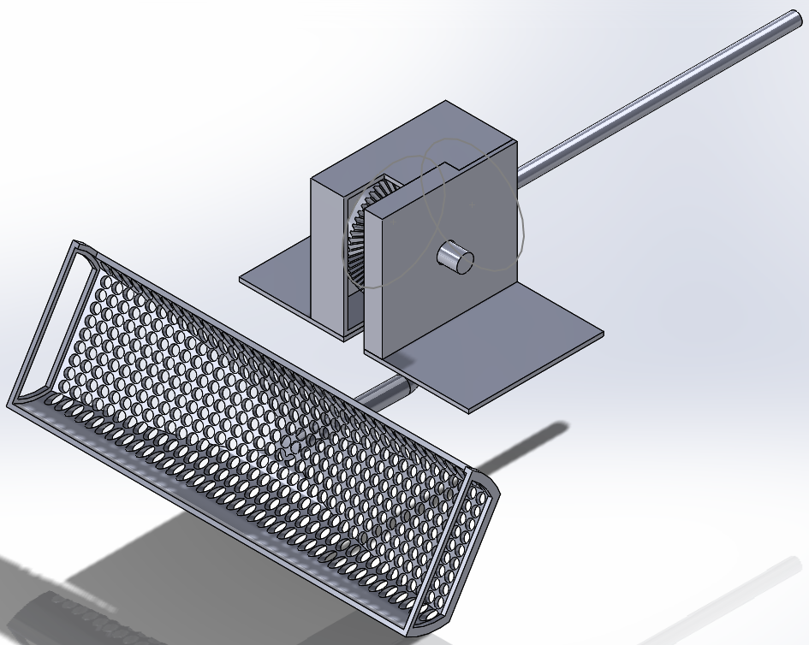
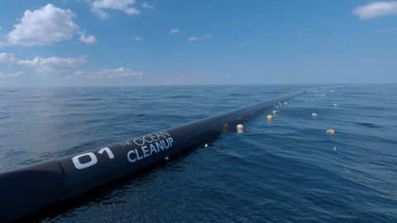
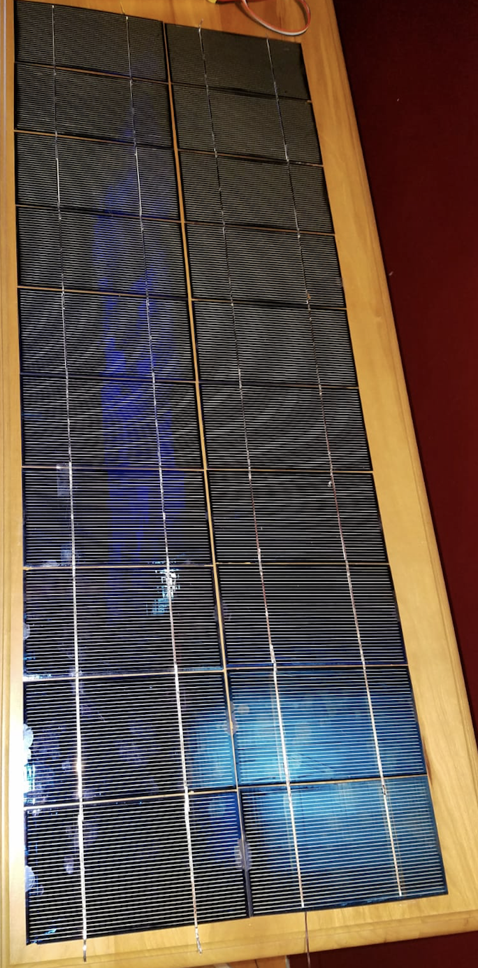
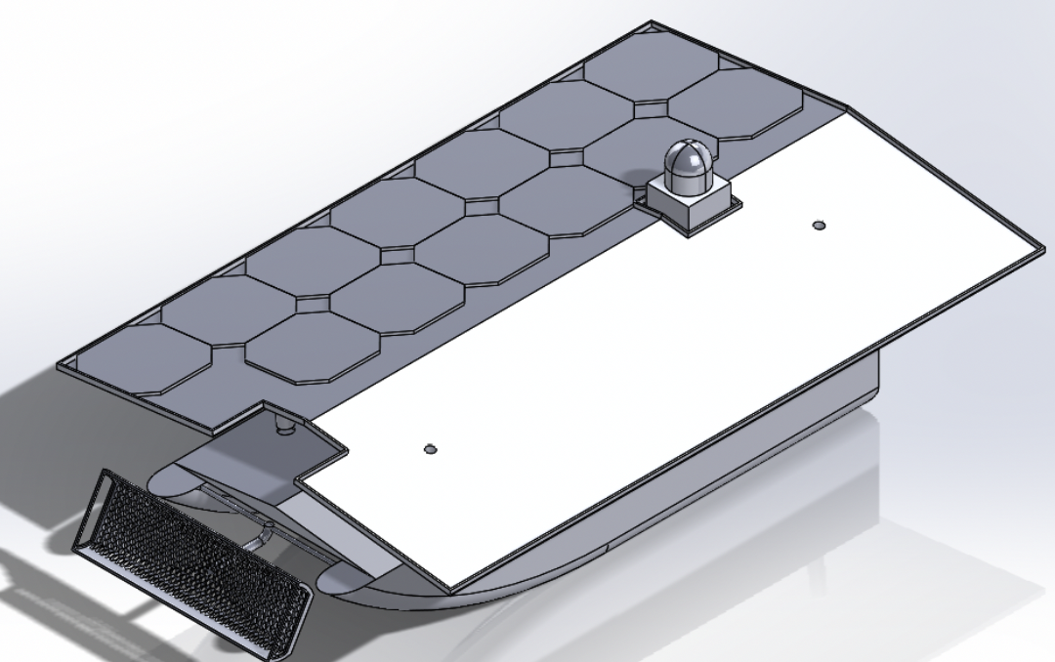
Garbage Patch Cleanup
Mohammad Alajmi, Nader Alajmi, Salman Alotaibi, Jake Goodman, Stephen Sauder
Department of Mechanical Engineering, Northern Arizona University, Flagstaff
Abstract
Design Concept and Design Statement
The design collects ping pong balls in a body of water an
Grabber transfers ping pong ball from water to collection bin through a connected motor. The motors will rotate the grabber through two perpendicular bevel gears.
Solar panels charging the boat’s battery.
Solar panels have to reach 14.8-16.8 to cover the voltage battery and charge it.
Platform holding the solar panels above the boat allowing sufficient exposure and surface area
Collection bin connected underneath the platform for sufficient volume
Camera takes pictures on intervals and registers ping pong balls in the photos
Summarized Design Research/Inspirational Images
The Ocean Cleanup was the inspiration
Autonomously collect plastic
Solar power for continuous collection
On board storage for collected plastic during voyage
A front loader inspired the grabber design
Figure 3: CAD Model of Grabber Assembly
Figure 4: The Ocean Cleanup Inspirational Idea
Gyres, created by ocean currents, form large patches of the trash within the ocean. While the small pieces that can be consumed by fish are problematic, the large pieces also are significant in the problem. As the process is tedious and in remote locations, an autonomous device running on solar energy, capable of locating and collecting the large pieces, effectively reduces the lasting effect of the garbage patch.
Background Information
Gyres, created by currents, create large clusters of trash. The pieces can range from 10 mm to undecomposed large materials. The consuming of the trash, transfers through the food chain, hurting the ocean wildlife to people.
Approach and Testing
To meet goals, the device is divided into the following:
Solar panels mounted platform charges batteries
Activating the motor attached to the grabber with a remote control, allows rotation of the grabber from the water to the collection bin
Equip a camera with arduino, having the camera take and save a photo every minute to an attached SD card
Project Goals
Device can:
Ocean Clean-up
Transfer trash from in front of boat, to on board storage
Locate Plastic
Autonomously take picture every minute
Solar Power
Mount cells
Charge on board batteries
Results
Solar panel reached 16.8 volts by using DC converter
Camera takes and saves a photo every minute to an attached SD card
Shaft can manually actuate the grabber but not remotely
Figure 1: Solar Panel
References
The Ocean Cleanup. (2019). The Ocean Cleanup Raises 21.7 Million USD in Donations to Start Pacific Cleanup Trials. [online] Available at: https://www.theoceancleanup.com/updates/the-ocean-cleanup-raises-217-million-usd-in-donations-to-start-pacific-cleanup-trials/ [Accessed 19 Apr. 2019].
Figure 2: CAD Model of the Device
Notes:
Sections
Abstract
Background
Project Goals
Design Approach and Testing/Results
Capture Viewers attention
White Background
Update images with context
how boat works
Cite images
Inform as if never seen project before
Change background color to white unless your planning on paying for the printing.
Review the poster rubric under the final draft poster assignment. ﻿﻿﻿﻿﻿﻿﻿﻿﻿﻿﻿﻿﻿This shows the required sections that the judges will be grading off of.
See comments.
Need to update images with context. Better convey information on how the boat works and analysis completed on it. Keep text formating the same. Include references for images that are not yours since that is plagiarism. Keep formatting the same.
Using bulletin points is good but make sure the information conveyed is enough for the judges who have never seen this project before.

